Slide 1
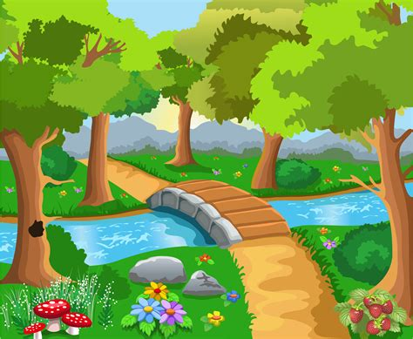


Healthy Lifestyle
2018-2019
Yulia Michurin

Slide 2
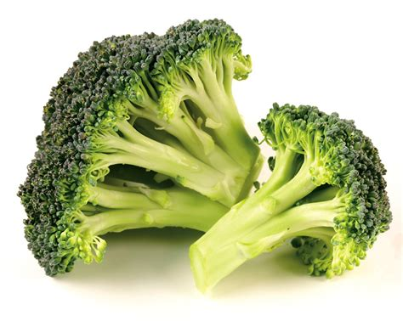
Let’s talk:
Why “Healthy Lifestyle”?
What can we do together?
What does it mean to be Healthy?
4. What do you do to be healthy?

Slide 3
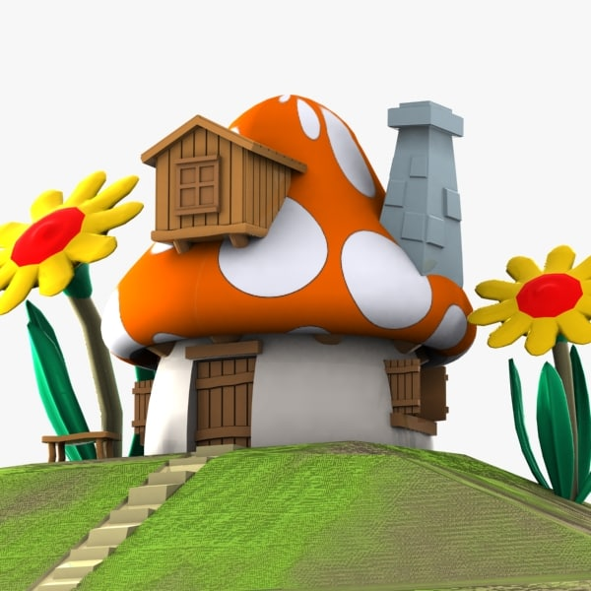
Let’s learn some words:
Health – בריאות
Lifestyle – אורח חיים
Sports – ספורט
Drink water – לשתות מים
Sleep – שינה
Food – אוכל
Fruits – פירות
Vegetables – ירקות
Menu – תפריט
Body – גוף
Add more

Slide 4

Unity
About our English Lessons:
We start it on the carpet.
I teach…☺
You work in groups of three or four.
You choose a leader. He/she presents.
Back to carpet.

Slide 5
Projects:
Health
My English Adventure
“Toronto”, Robotics, Math
Pen Pals
Notes:
Health: Spelling Bee, Parents/Children, Sports Activity, Presentations - speaking

Slide 6




For our lessons you need:
Your books
Your notebook (a line for words*)
Pencils, colors, scissors, glue
Good mood☺

Slide 7



Rules in our house:
Let’s work on it
Notes:
Worksheets

Slide 8

I finished:
Check your work.
Choose three words from the lesson. Write it down three times.

Slide 9



Collect

Slide 11















Let’s play a game:

Slide 12

Notes:
Gimel: English room, My first English Adventure, presentation, letters – ppt ABC, Dalet – presentation, what they know, Hey – 4,5,6. Mipuim.

